Slide 1
CONSUMER COMPLAINTS
DATA ANALYSIS
BY YOGINI VIRKAR

Slide 2
Problem Statement:
You have been hired as a Data Analyst for a consumer protection organization. Your task is to
explore complaints lodged against Bank of America and identify areas that need attention from
both the business and policy-making perspectives.
Your Analysis Should Include:
1. Seasonal Trends:
o Are there any months or seasons when consumer complaints spike?
o Can you identify patterns across years?
2. Product-Level Insights:
o Which financial products receive the most complaints?
o What are the top 3 issues associated with the top product?
3. Resolution and Timeliness:
o How are complaints typically resolved (e.g., closed with explanation, relief
provided)?
o What percentage of complaints receive untimely responses?
4. Deeper Insights (Optional):
o Are untimely responses more frequent for specific product types or issues?
o How does resolution type vary across complaint categories?

Slide 3
🗂️ Dataset Overview:
This dataset captures consumer complaints submitted to the Consumer Financial Protection Bureau (CFPB) regarding financial products and services offered by Bank of America between 2017 and 2023. It enables deep analysis of customer dissatisfaction, issue patterns, resolution efficiency, and organizational accountability
📌 Key Features of the Dataset
🔹 Complaint Details
Complaint ID – Unique identifier for each complaint
Date Submitted – Date when the complaint was filed by the consumer
Date Received – Date the CFPB received the complaint
🔹 Product Information
Product – Main financial product involved (e.g., Credit card, Mortgage, Checking account)
Sub-product – More specific product classification (e.g., General-purpose card, Home equity loan)

Slide 4

SQL Queries

Slide 5
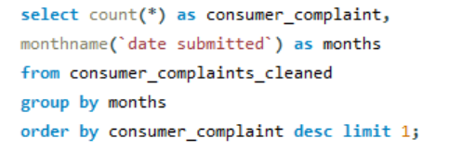
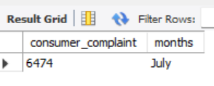
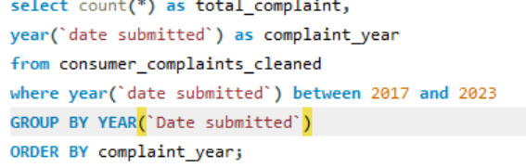
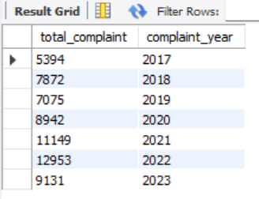
Seasonal Trends analysis.
1.1 find months when consumer complaints spike?
1.2 identify patterns across years?

Slide 6
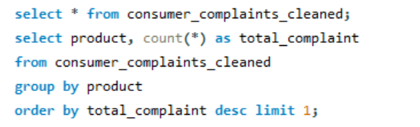
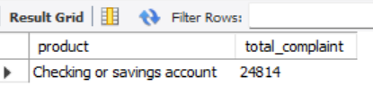
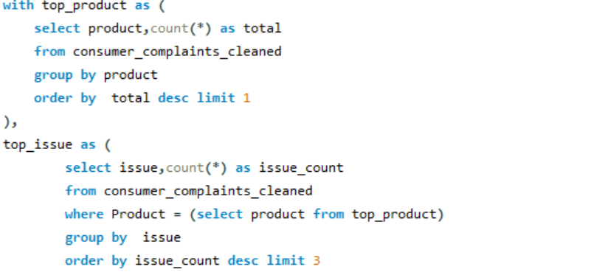
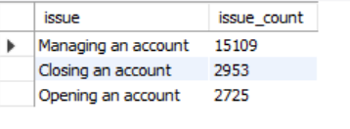
Product-Level Insights:
2.1 Which financial products receive the most complaints?
2.2 What are the top 3 issues associated with the top product?

Slide 7
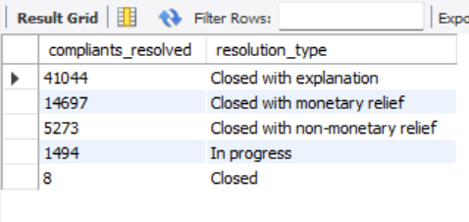
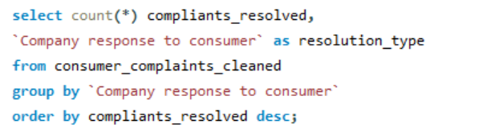
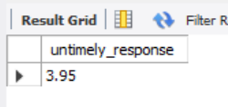
Section 3: Resolution and Timeliness
3.1 How are complaints typically resolved?
3.2 What percentage of complaints receive untimely responses?

Slide 8
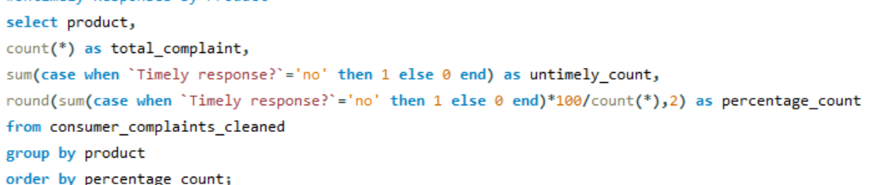
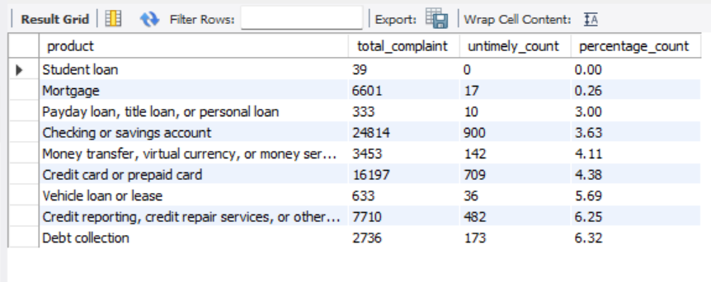
deeper insights
4.1 Are untimely responses more frequent for specific product types or issues?
Untimely Responses by Product

Slide 9
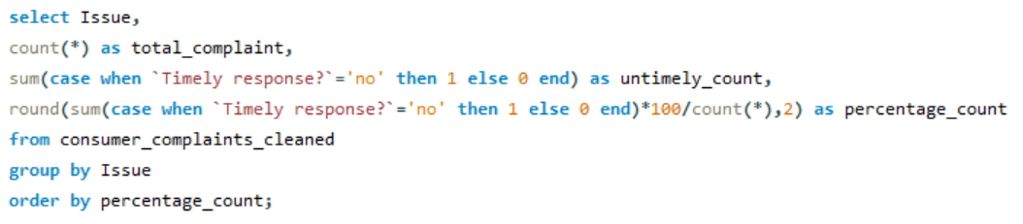
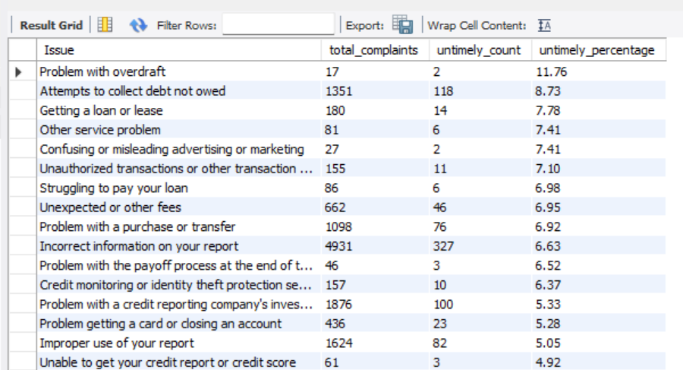
✅ Untimely Responses by Issue

Slide 10
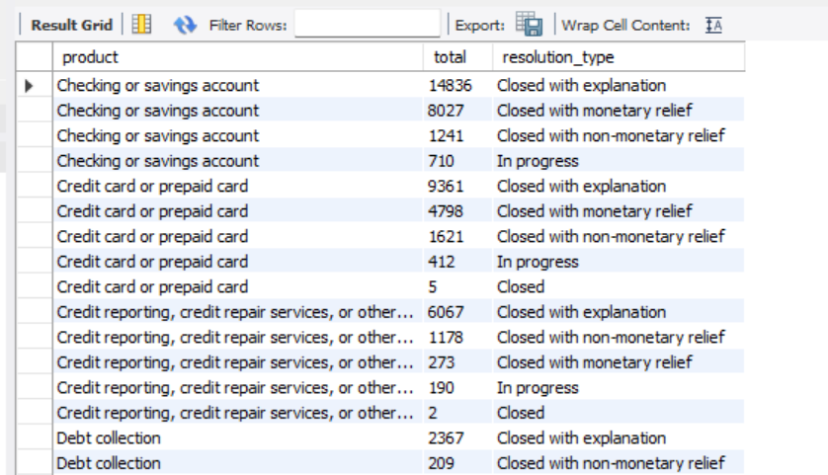
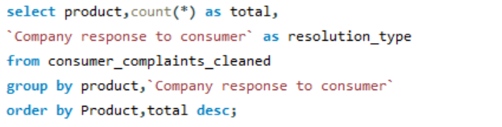
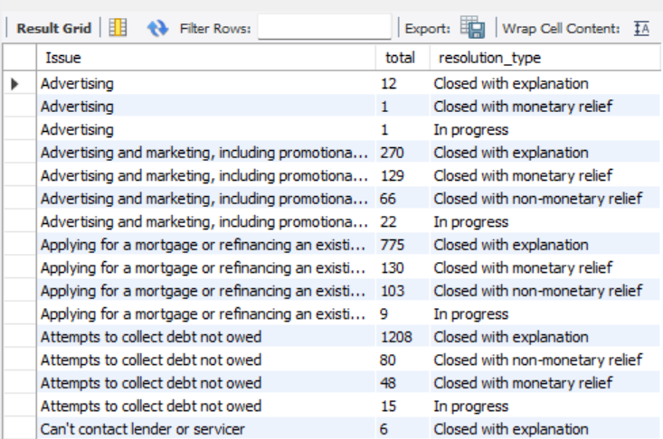
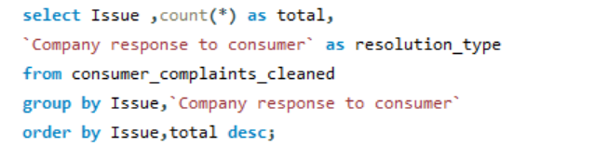
4.2 How does resolution type vary across complaint categories?
Resolution by Product
Resolution by Issue

Slide 11
Insights & Actions
🔶 1. Seasonal Trends
Insight:
Complaints show noticeable spikes in certain months (likely December or other year-end periods as per the SQL query).
Year-over-year analysis can reveal whether complaint volumes are increasing, stable, or declining.
Action:
Allocate more support staff during high-complaint months to ensure timely resolution.
Investigate seasonal factors (e.g., billing cycles, holidays, policy changes) that might drive complaint surges.
Implement proactive customer communication strategies before peak periods.
🔶 2. Product-Level Insights
Insight:
Certain financial products like credit cards or mortgages receive significantly more complaints than others.
Within the most complained product, a few recurring issues dominate (e.g., “billing disputes” or “account closures”).
Action:
Review policies and procedures associated with high-complaint products.
Launch targeted customer education programs to reduce misunderstandings.
Use issue-level insights to prioritize improvements in product design or customer service for the top 3 issues.

Slide 12
🔶 3. Resolution & Timeliness
Insight:
The majority of complaints are resolved with "Closed with explanation" or "Closed with monetary relief".
A measurable percentage of complaints (as shown in your query) receive untimely responses.
Action:
Improve response tracking systems to flag and escalate overdue cases.
Set internal SLAs (Service Level Agreements) stricter than regulatory deadlines.
Train agents on the importance of timeliness for both regulatory compliance and customer trust.
🔶 4. Deeper Insights
➤ 4.1 Untimely Responses by Product & Issue
Insight:
Some product types or complaint categories have a higher rate of delayed responses, possibly due to process complexity or volume.
Action:
Perform root cause analysis on the top offending products/issues.
Introduce automation tools (e.g., pre-response templates, AI-based triage) for frequently delayed categories.
Reallocate team bandwidth or add expertise for those high-delay areas.

Slide 13
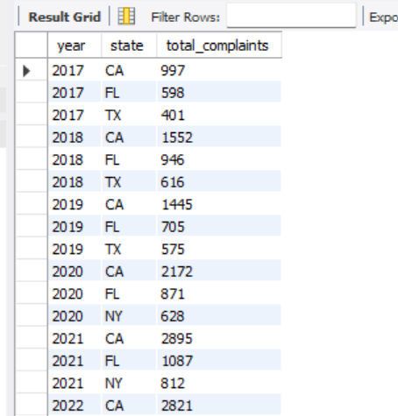
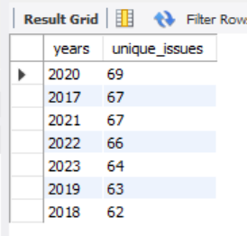
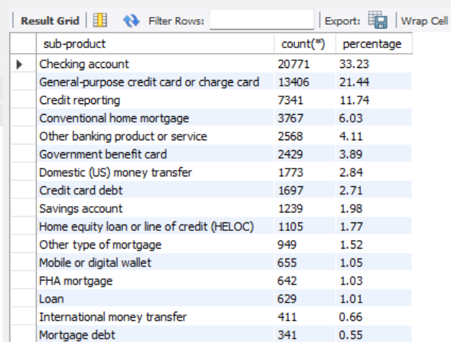
Top 3 complaint states each year
Number of unique issues per year
Complaint share of each sub-product.

Slide 14
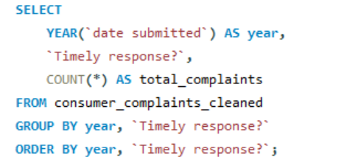
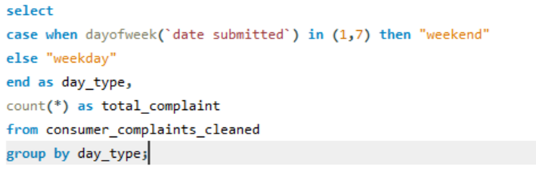
Total complaints for each response type across years.
Count complaints by weekday vs. weekend.

Slide 15
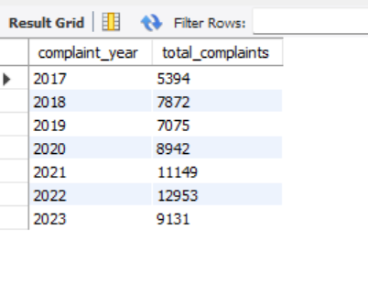
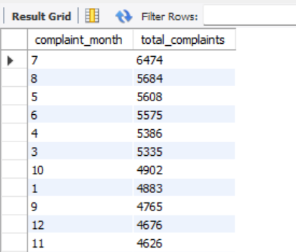
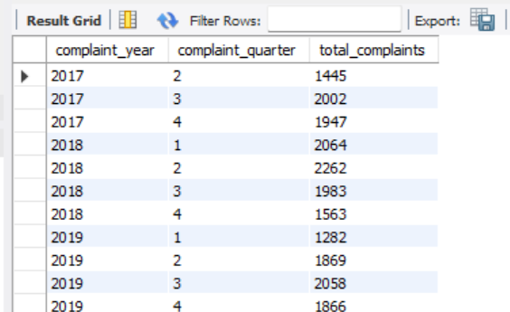
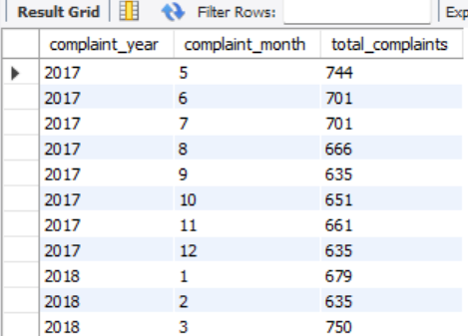
#1. Seasonal Trends – SQL Queries
#🔹 A. Monthly & Yearly Trends (Basic)
#1. Total complaints per month (all years)
#2. Total complaints per year
#4. Total complaints per quarter
#3. Monthly complaints for each year

Slide 16
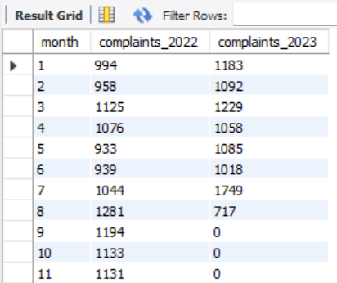
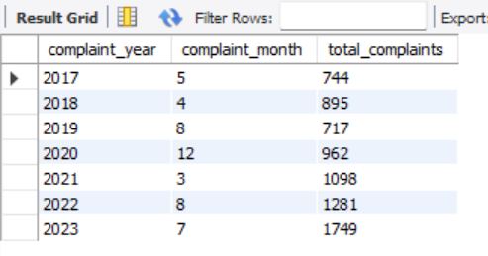
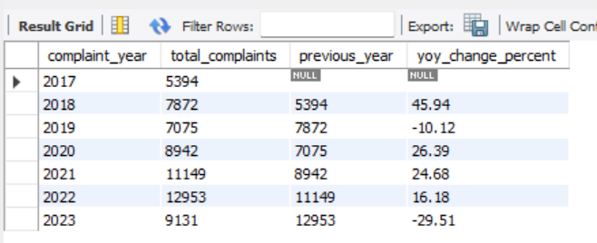
#🔹 B. Trend Insights (Intermediate)
#7. Compare complaint volumes between 2 years (e.g., 2022 vs 2023)
#9. Find peak complaint month per year
#8. Calculate YoY change in complaints

Slide 17
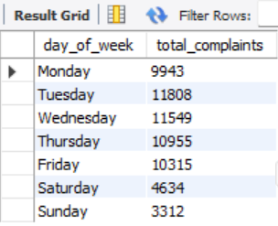
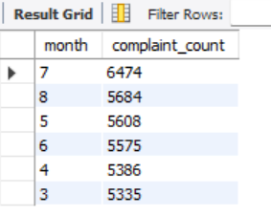
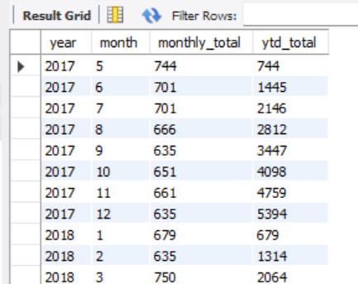
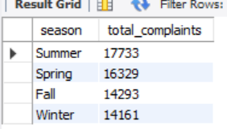
#C. Weekday/Weekend & Seasonal Buckets (Advanced)
#10.Complaints by weekday (Mon–Sun)
#12.Identify months with above-average complaint volumes
#11. Complaints by season (Spring, Summer, Fall, Winter)
#13.Cumulative complaints year-to-date

Slide 18
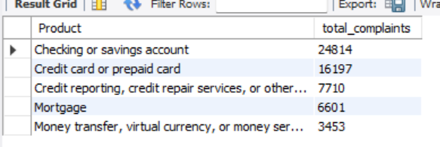
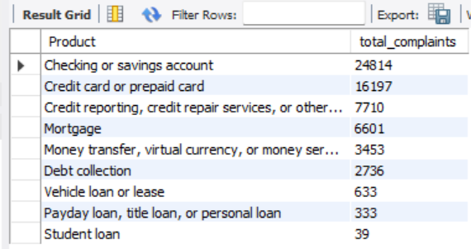
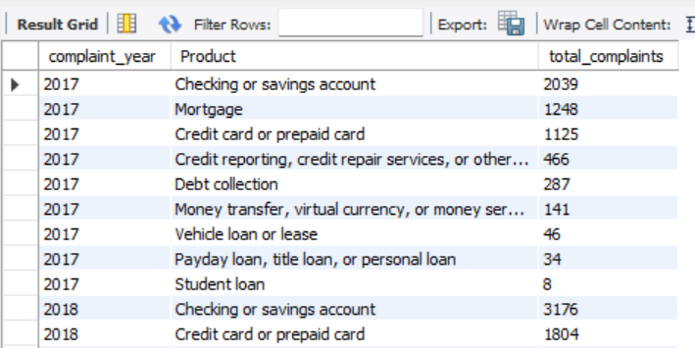
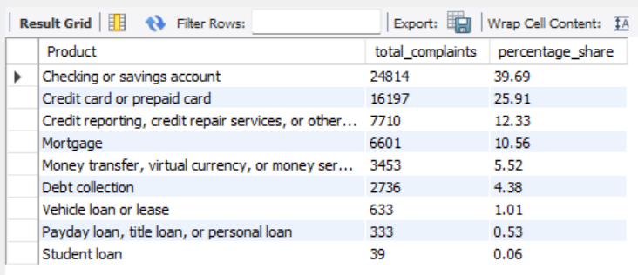
#2. Product-Level Insights – SQL Queries
# A. Product Complaint Volume (Basic)
#1. Total complaints per product
#2. Top 5 most complained products
#3. Percentage share of each product
#4. Product complaint count per year

Slide 19
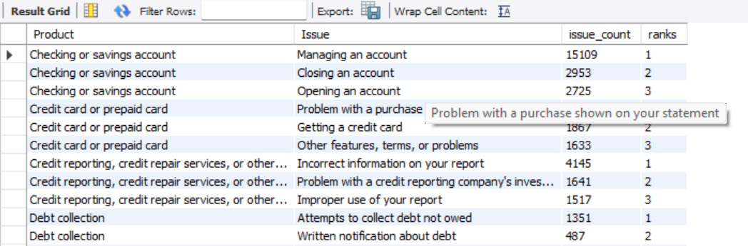
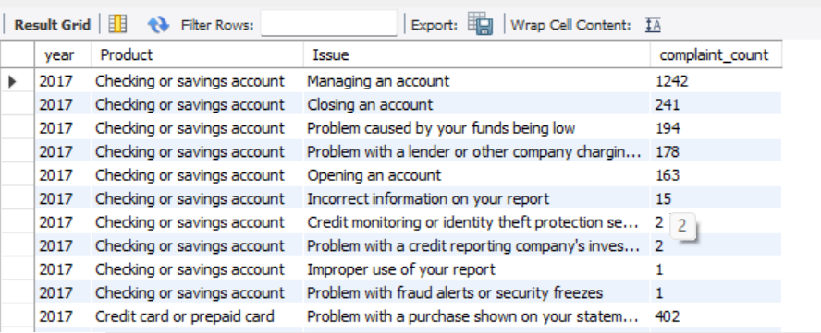
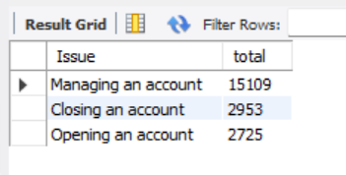
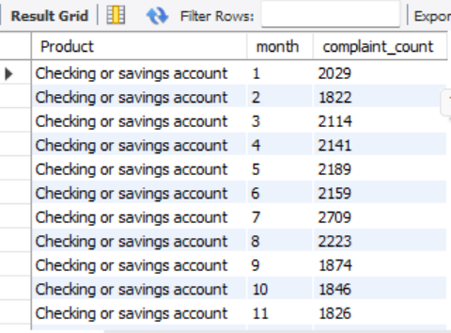
#🔹 B. Top Issues per Product (Intermediate)
#5. Top 3 issues for each product
#9. Yearly complaints by product and issue
#6. Issues for the top product only (with subquery)
#🔹 C. Product & Issue Trends (Advanced)
#8. Monthly complaints by product

Slide 20
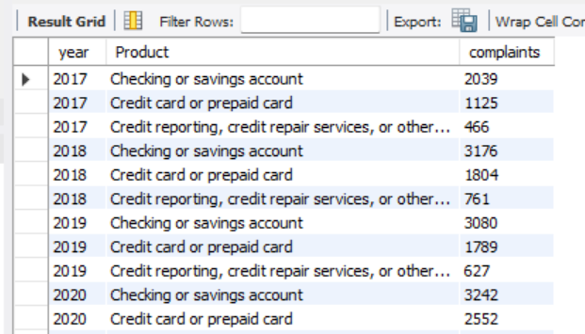
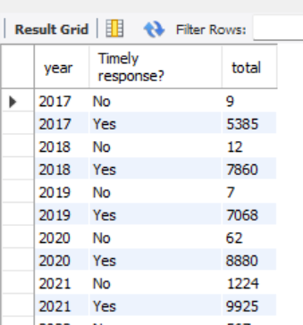
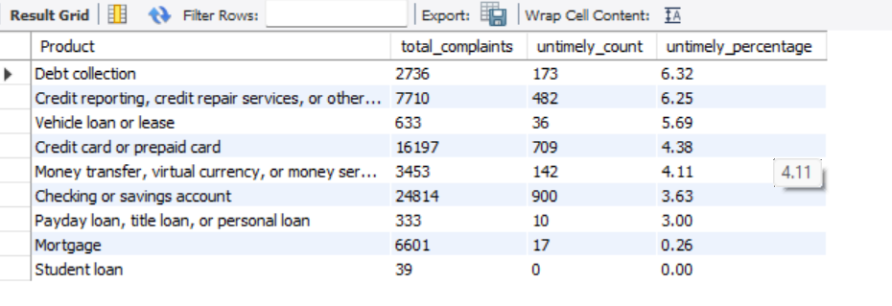
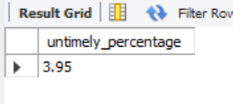
#10.Complaint volume trend for top 3 products
#6. Timely vs Untimely response by year
#🔹 B. Timeliness of Responses (Intermediate)
#4.Percentage of untimely complaints
#5. Product-wise untimely response rate

Slide 21
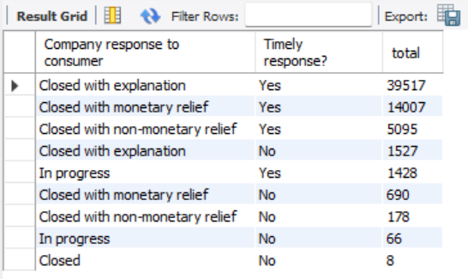
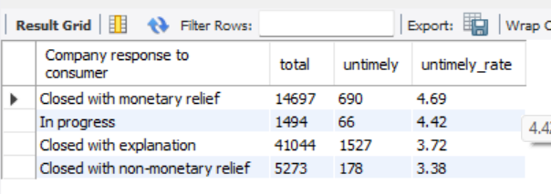
#C. Resolution + Timeliness (Advanced)
#8. Timeliness distribution across resolution types
#9. Top 5 resolution types with highest untimely response rate

